Slide 1

Handwritten Digit Recognition with MNIST
Recognizing handwritten digits is a fundamental problem in machine learning. The MNIST dataset provides a standard benchmark for this task. It has numerous applications in various industries.
22R11A6770
22R11A6756
23R11A62J6

Slide 2




Introduction to Handwritten Digit Recognition
Automatic Digit Identification
Optical Character Recognition
The goal is to identify digits (0-9) from images automatically.
This technology is crucial for Optical Character Recognition (OCR) systems.
Handwriting Variability
Significant challenges arise from diverse handwriting styles.

Slide 3
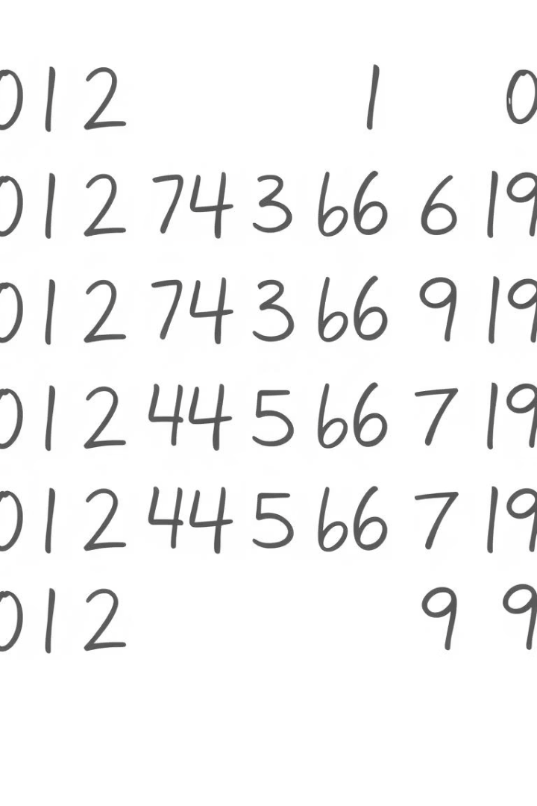
The MNIST Dataset
60K
Training Images
60,000 images are used for training models.
10K
Testing Images
10,000 images are reserved for testing performance.
28x28
Pixel Resolution
Each image is 28x28 pixels and grayscale.
99.79%
State-of-the-Art Accuracy
The highest reported accuracy on this dataset.

Slide 4





Model Architecture
Convolution Layers
Feature extraction from images.
Pooling Layers
Reduces dimensionality and noise.
Activation (ReLU)
Introduces non-linearity.
Fully Connected Layers
Final classification decisions.
Convolutional Neural Networks (CNNs) are standard. Classic examples include LeNet-5, while modern approaches use Transformers.

Slide 5
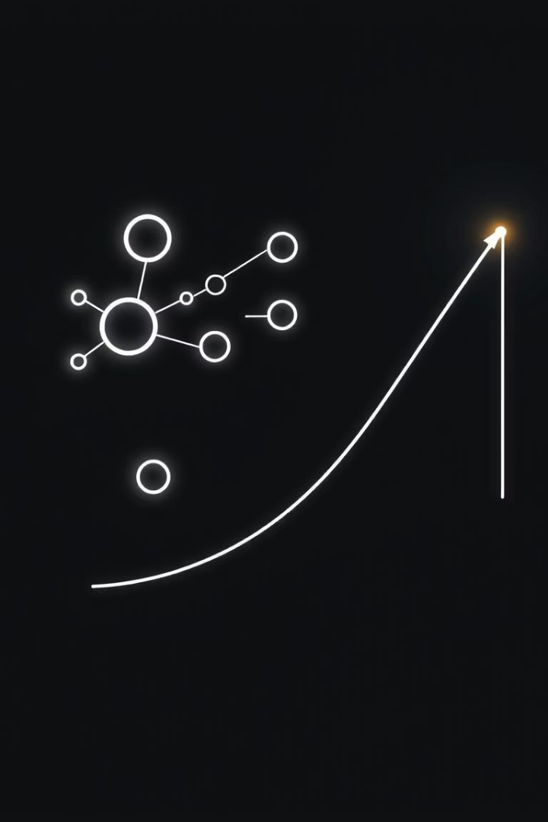




Training the Model
Loss Function
Optimizer
Metrics
Categorical cross-entropy guides learning.
Adam or SGD algorithms adjust weights.
Accuracy, Precision, and Recall measure performance.
Data Augmentation
Enhances generalization, preventing overfitting.

Slide 6
Evaluation and Results
Key Metrics
Performance Benchmarks
Accuracy assesses correct predictions.
Baseline accuracy: >95% is common.
Confusion Matrix visualizes errors.
State-of-the-art: >99% achievable.
Monitoring training versus validation performance helps identify overfitting.

Slide 7

Challenges and Future Directions
Writing Style Variations
Inconsistencies in handwriting pose a significant hurdle for robust recognition.
Occlusion and Noise
Partially hidden or noisy images can degrade model performance.
Adversarial Attacks
Models need improved robustness against malicious inputs.
Edge Deployment
Future focus includes efficient deployment on low-power devices.

Slide 8








Applications and Conclusion
Postal Automation
Banking Operations
Efficiently sorts mail by recognizing addresses.
Automates check processing and detects fraud.
Gateway to Vision
General Image Recognition
MNIST is a foundational step for advanced computer vision.
Extends to broader computer vision tasks.

